Slide 1

MARQUEE SPONSOR

Slide 2

PLATINUM SPONSOR

Slide 3

PLATINUM SPONSOR

Slide 4

PLATINUM SPONSOR

Slide 5




GOLD SPONSORS

Slide 6




SILVER SPONSORS

Slide 7
30 Tips and Tricks for the ASP.NET Developer
Adam Tuliper
Software Architect
Cegedim

Slide 8


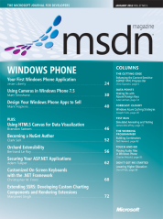
About Me
Adam Tuliper
Code at github under adamtuliper
Twitter: @AdamTuliper
CompleteDevelopment.blogspot.com
pluralsight .com author
MSDN Security Topics - December, January
Questions, Comments, etc
adam.tuliper@gmail.com
Notes:
Possible training videos coming soon via pluralsite.

